Slide 1
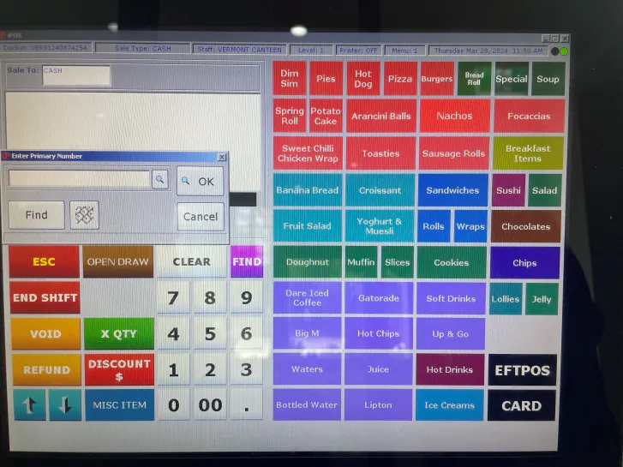






Inspiration for design 1

Slide 2
Draff 1 – Based on La Strada
Grid based Function, Keypad and item display
Depending on certain actions, a separate window will pop up, where details of what the user may to do in relation to the functions
Option tick mark to extend the window, witch adds a textbox, acting as a log of actions and data for trubbleshooting purposes
Order Preview + Cost Total
Item Displahy
Functions
Functions such as remove item,
Keypad.
A standard keypad.

Slide 3
Cart Text Box
Buttons
Log
Undoing Actions
Functions:
(Clear, Edit, Login, Logout, Apply Discount)
Cash
Card

Slide 4
Amount Owed
*A Series of images of each denomination of aus cash, with a text box underneath each*
*only appears on cash payment*
Amount Payed
Differece
Complete Payment

Slide 5
Payment Window
Cash

Slide 6
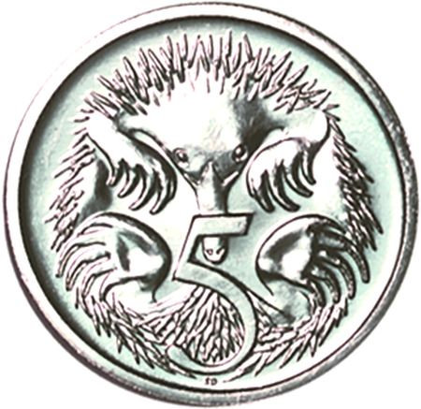
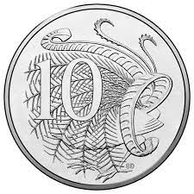
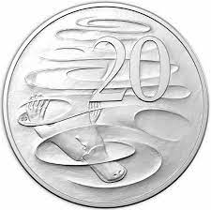
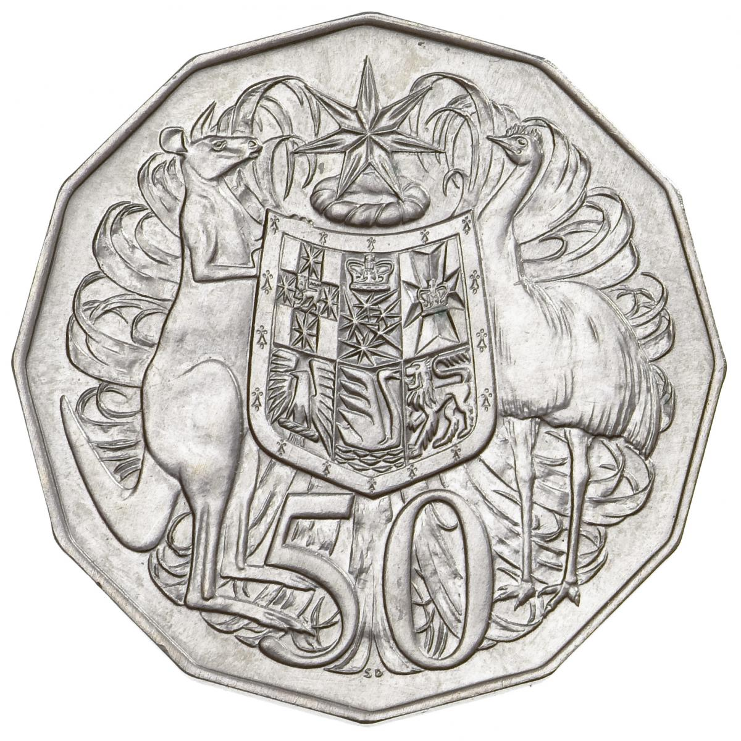
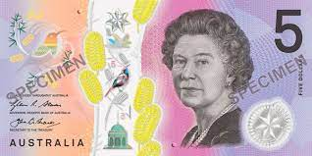
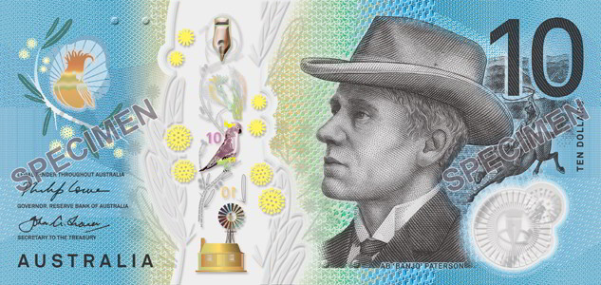
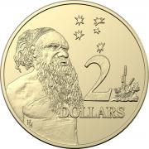
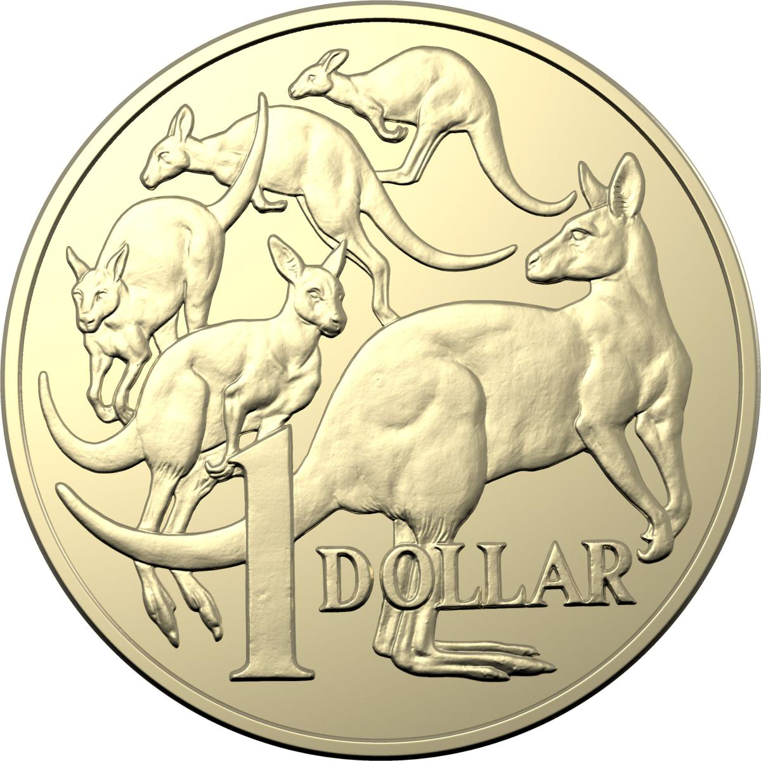
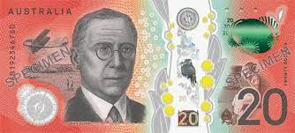
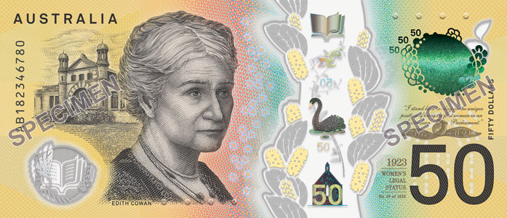
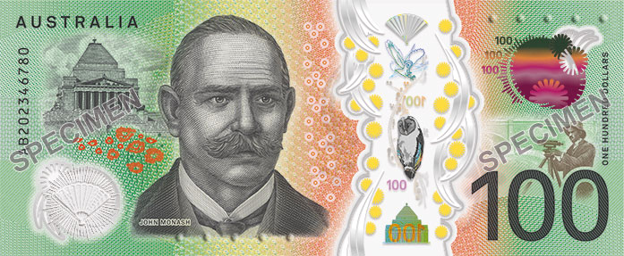
Go Back
Amount Owed
#
#
Amount Owed
#
#
#
#
Amount Payed
#
Amount Paid
#
#
Change / Difference
Difference
#
#
#
#
#
Give Change and Complete Payment
#
#
#
#
#
#
#

Slide 7
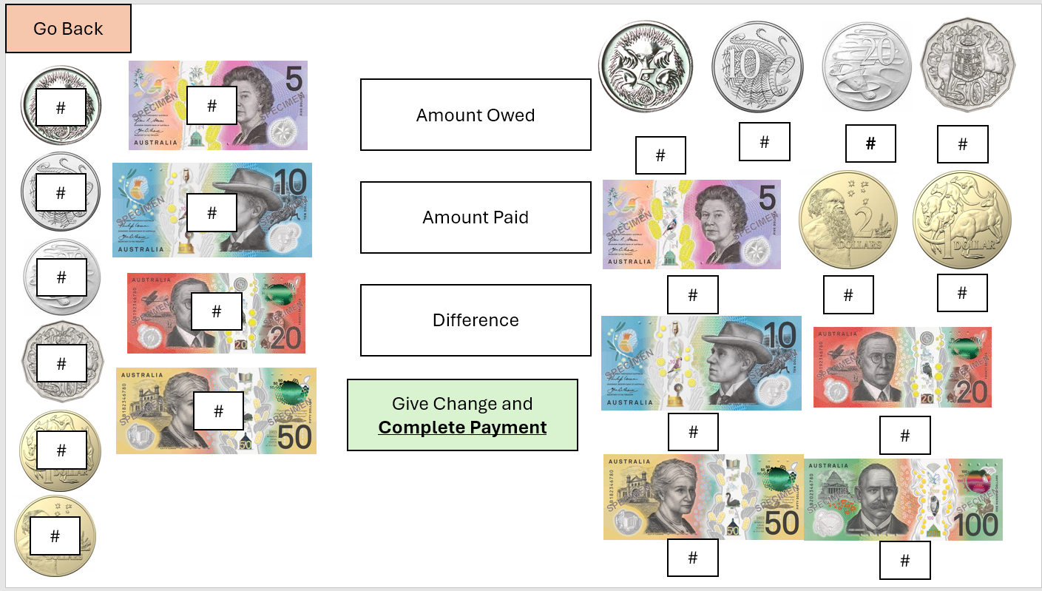
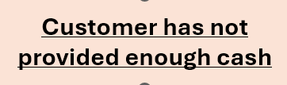
This displays the total amount Paid by the customer
(Calculated based on numbers in the text boxes on the buttons on the right)
This displays the total amount owed by the customer
These are text boxes that display how many of each denomination of currency has been given by the customer. If the cashier makes a mistake, or if it is quicker to type how many the customer has provided, they can be edited manually, as an alternative to tapping each button
Exits the cash payment window, and goes back to home screen. No cart data is lost.
The images of each denomination of money, are buttons. The cashier taps each denomination, however many times that the customer gives that specific denomination.
For Example:
If a customer gave the cashier 3, 2 dollar coins, and 5, 50 cent coins, the cashier would tap the 50 cent button 5 times, and the 2 dollar button 3 times.
When the difference is positive, the program will calculate what denominations of currency to give as change. These text boxes display how much of each denomination should be given as change, differentiated by the denomination of currency behind them.
)
This displays the Difference between what is owed and payed.
If its negative, it means the customer still owed more money.
If its positive, It means change must be given.
Once the difference is positive, or zero, this button will turn green. Otherwise, the button will look like this
And will not allow for payment to commence
Notes:
Descriptions of what each thing does

Slide 8
txtAmountOwed
txt5cCount, txt10cCount, txt20cCount, txt50cCount, txt1dCount (and so on)
txtAmountPaid
cmdGoBack
cmd5c, cmd10c, cmd20c, cmd50c, cmd1d, cmd2d, cmd5d, cmd10d, cmd20d, cmd50d, cmd100d.
txt5cChange, txt10cChange, txt20cChange, txt50cChange,
txt1dChange, (and so on)
txtDifference
cmdCompleteCashPayment
cmdInsufficientCash
Notes:
Their names in data dictionary

Slide 9
Example of being Over Payed
Number 1

Slide 10
Go Back
Amount Owed
0
$12.45
0
3
0
0
0
Amount Payed
0
$13.15
0
1
Change / Difference
$0.70
1
4
0
0
1
0
Give Change and Complete Payment
0
0
0
*Notice how change is calculated on the left, and how the Change/Difference text box is positive, and the Complete Payment button is visible
0
0
0

Slide 11
Example of being Over Payed
Number 2

Slide 12
Go Back
Amount Owed
1
$12.45
1
0
0
0
0
Amount Payed
0
$20
0
0
Change / Difference
$7.55
0
0
0
0
1
0
Give Change and Complete Payment
0
1
0
*Notice how change is calculated on the left, and how the Change/Difference text box is positive, and the Complete Payment button is visible
2
0
0

Slide 13
Example of being Under Payed

Slide 14
Go Back
Amount Owed
0
$12.45
0
0
0
0
0
Amount Payed
0
$10
0
0
Change / Difference
-$2.45
0
0
0
0
0
0
Customer has not provided enough cash
1
0
0
*Notice how change is not calculated on the left, and how the Change/Difference text box is negative, and the Complete Payment button is invisible
0
0
0

Slide 15
Payment Window
Card

Slide 16
Go Back
Amount Owed
Amount Owed
Amount Paid
Amount Paid
Card Status
Card Status
Complete Payment

Slide 17
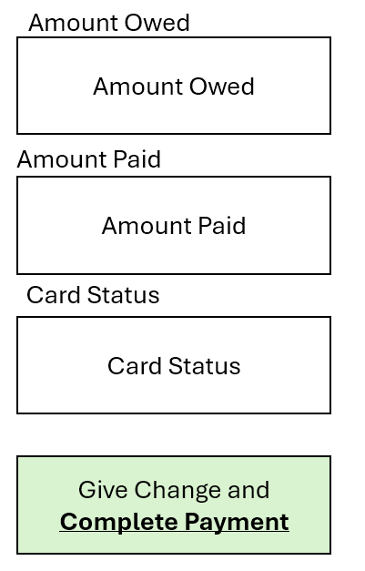
It is strikingly similar to the cash payment window, however with a lot of unescecary things removed.
There is no “change” that can be given or needed to be given when using a debit or credit card, withc is why the “difference” text box is not displaid, but instead a “Card Status” Text Box.
Once an attempted card purchase is made, the card status text box will display any error with the card, such as insufficient funds, or just an error with communicating with the card.
If it is approved however, the card status will say “transaction aproved”, witch is when the “Complete Payment” Button appears.

Slide 18
If customer has not payed, then instead of the “complete payment button” being displayed, instead it is the “Customer has not yet payed” Button.
Customer has not yet payed

Slide 19
Main Screen
:o

Slide 20
Hot Chocolate (3.50)
X1 - $3.50
(2) Cookie (2.5)
*FREE WITH COFFE
X1 - $0.00
Total:
$3.50
Edit Items
Clear Order
Or
Cancel Order
Begin Shift/End Shift
Discount
Card
Cash

Slide 21
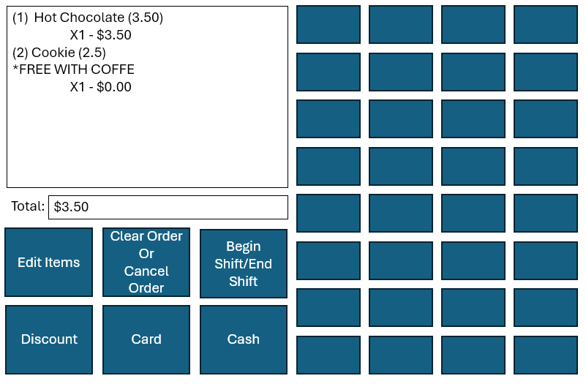
Each button here is an item, witch is noted as being in a certain row or columb. Depending on what the user sets In a csv table, one can customize the name, colour and price of each item.
Every time one of these items Is pressed once, It gets added to the cart, once.
This opens the CSV file containing data for each item sold
Opens the discount menu, where an overall discount can be made on the purchase, or a deduction from the price
These open their payment windows respectivley

Slide 22
cmdX_Y
txtCart
txtCartTotal
cmdBeginShift
cmdEndShift
cmdClearCart
cmdEditItems
cmdDiscount
cmdCard
cmdCash

Slide 23
Discount Window

Slide 24
GO BACK
Percentage Discount
XXXXX
Percent off
Exact Discount
XXXXX
Off final price
APPLY DISCOUNT

Slide 25
Shift Window
Beginning Shift

Slide 26
GO BACK
Name
BEGIN SHIFT

Slide 27
Shift Winow
Ending Shift

Slide 28
GO BACK
0:00:00
Name
End Shift

